Slide 1
Skewed Classes, Precision and Recall, F1 Score
CSN-382

Slide 2
Learning with Imbalanced Data
Dealing with imbalanced data
Settings where one or more classes receives extremely few data points
Motivating examples from binary/multiclass datasets
Techniques to overcome imbalance
Dataset modification
Loss modification

Slide 3
Imbalance is common – Binary Classfn
Valid credit transactions
Don’t have disease
Molecule is inactive
Mail not spam
Fraudulent transactions
Molecule is medicinal
Spam
Mail
Have disease
In anomaly detection, medical diagnosis, drug discovery, spam filtering and many other domains, data is heavily imbalancd
Lots of data may be available in total but very less (0.01% or lesser) may belong to the “rare” class e.g. 100000 red vs 10 green
Trivial for a classifier to get 99.99% accuracy (simply predict everything red)
May be disastrous, e.g. if green class denotes a rare disease or fraudulent transaction
Many ML algorithms that are designed to greedily chase classification accuracy may completely ignore green training data points since it is easy to do well on red data points
The whole purpose of learning is lost if the above happens ☹

Slide 4
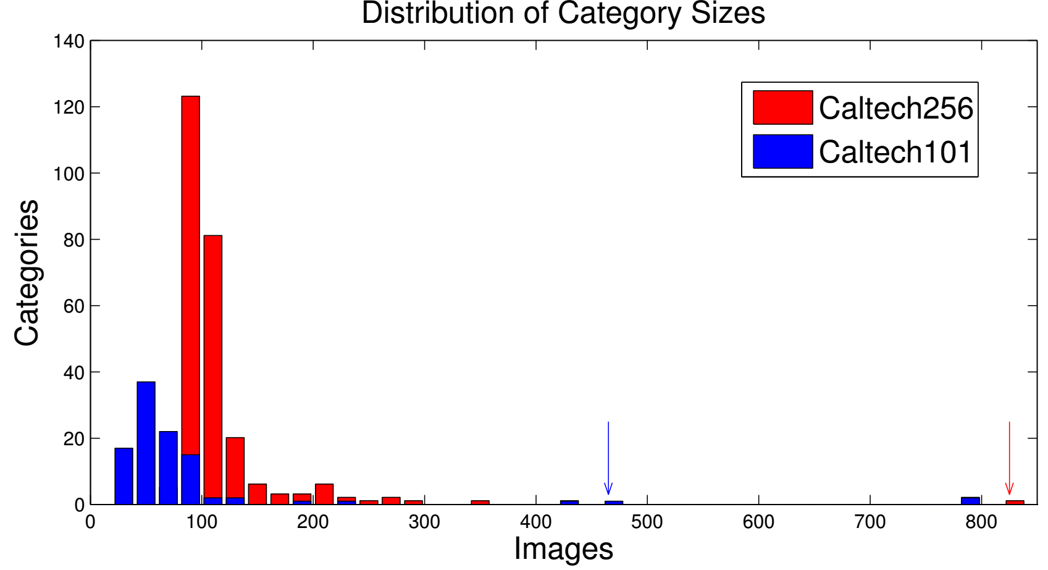
Imbalance is common – Multi Classfn
Caltech-256 is an object detection dataset with 256 classes
Simple averaging argument shows that 50% of classes must each have less than 0.8% of the data
Lots of data for few classes but most classes impoverished
In fact, rarest class has only 80 images, most popular 800 images
Makes learning challenging
Easier to do well on popular classes with lots of data points e.g. cats
Difficult to handle rare classes
Notes:
The main issue in imbalanced datasets is to handle rare classes.

Slide 5
Solutions to Label Imbalance
Get more data for the rare classes so that they don’t remain rare ☺
Generate artificial data for rare classes to make them more prominent
Change training algorithms that artificially make rare classes prominent
Includes using loss functions that are aware of class imbalance
Use different learning strategies for rare classes and popular classes
A combination of all of the above may be required in practice

Slide 6
Dataset Modification Techniques
A bit pointless to handle label rarity problem by making all labels rare. Would be like a hypothetical administration that aims at equidistribution of wealth but ends up with equidistribution of poverty instead
Undersample the popular class so that it does not dominate
Actually throwing out data not a very good idea since it throws away data
In practice we may give smaller weights to popular class points
Oversample the rare class by repeating each rare point (say 100 times)
Not done explicitly since that would needlessly increase train set size+time
Implicitly done by giving higher weights to rare class points
A technique SMOTE (Synthetic Minority Oversampling TEchnique) however actually samples new data points around rare class points

Slide 7
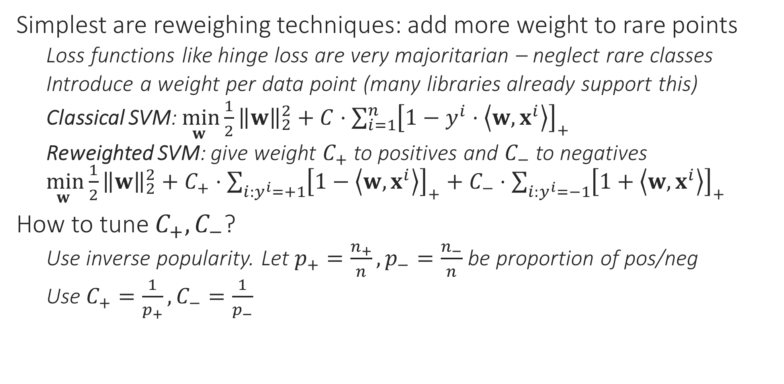
Imbalance-aware Training Techniques
Simplest are reweighing techniques: add more weight to rare points
Loss functions like hinge loss are very majoritarian – neglect rare classes
Introduce a weight per data point (many libraries already support this)
Classical SVM: $\min_{w }{\frac{1}{2}{\left\|w\right\|}_{2}^{2}}+C⋅\sum_{i=1}^{n}{{\left[1−y^{i}⋅\left\langle w,x^{i}\right\rangle \right]}_{+}}$
Reweighted SVM: give weight $C_{+}$ to positives and $C_{−}$ to negatives $\min_{w }{\frac{1}{2}{\left\|w\right\|}_{2}^{2}}+C_{+}⋅\sum_{i:y^{i}=+1}{{\left[1−\left\langle w,x^{i}\right\rangle \right]}_{+}}+C_{−}⋅\sum_{i:y^{i}=−1}{{\left[1+\left\langle w,x^{i}\right\rangle \right]}_{+}}$
How to tune $C_{+},C_{−}$?
Use inverse popularity. Let $p_{+}=\frac{n_{+}}{n},p_{−}=\frac{n_{−}}{n}$ be proportion of pos/neg
Use $C_{+}=\frac{1}{p_{+}},C_{−}=\frac{1}{p_{−}}$

Slide 8
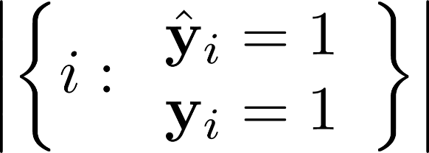
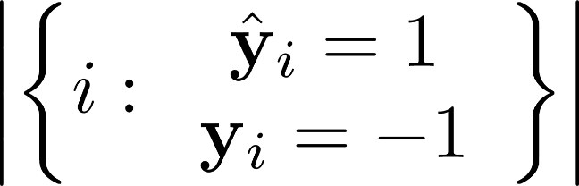
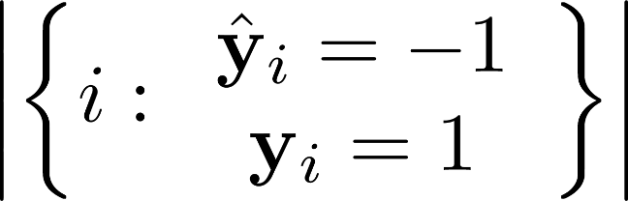
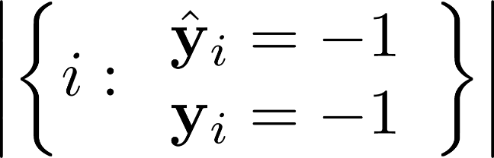


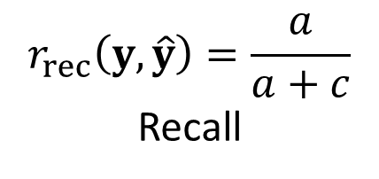
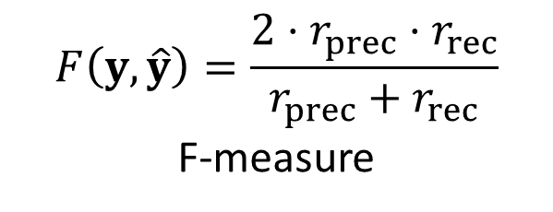
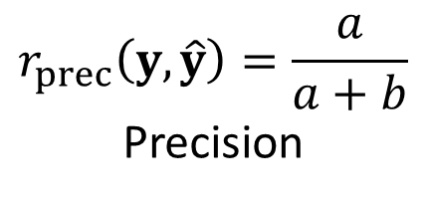
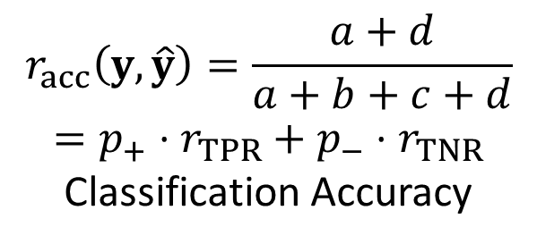
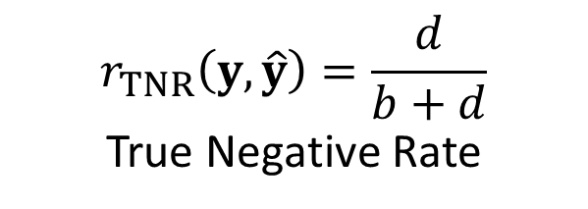
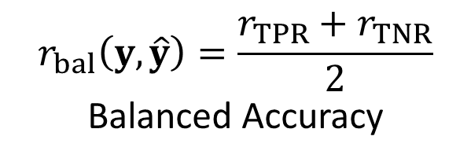
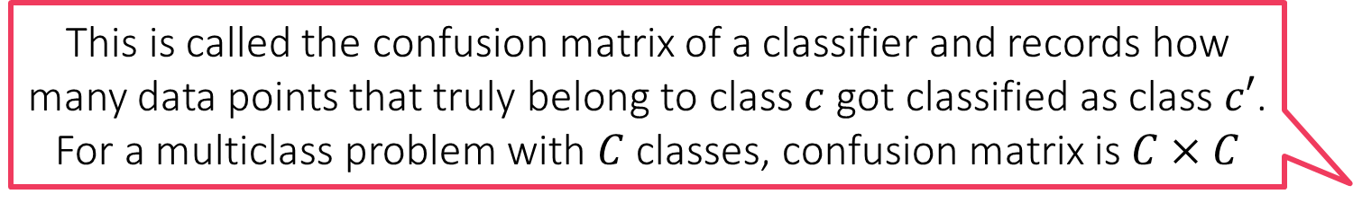
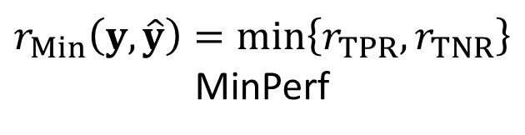
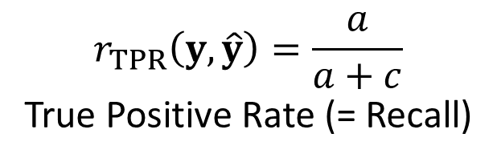
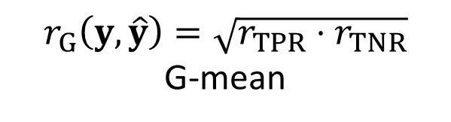
Imbalance-aware Training Techniques
This is called the confusion matrix of a classifier and records how many data points that truly belong to class $c$ got classified as class $c′$. For a multiclass problem with $C$ classes, confusion matrix is $C×C$
Use loss fns that themselves penalize models that neglect rare classes
a
b
$$r_{acc}\left(y,\hat{y}\right)=\frac{a+d}{a+b+c+d}$$
$$=p_{+}⋅r_{TPR}+p_{−}⋅r_{TNR}$$
Classification Accuracy
c
d
$$r_{bal}\left(y,\hat{y}\right)=\frac{r_{TPR}+r_{TNR}}{2}$$
Balanced Accuracy
$$r_{TPR}\left(y,\hat{y}\right)=\frac{a}{a+c}$$
True Positive Rate (= Recall)
$$r_{TNR}\left(y,\hat{y}\right)=\frac{d}{b+d}$$
True Negative Rate
$$r_{prec}\left(y,\hat{y}\right)=\frac{a}{a+b}$$
Precision
$$F\left(y,\hat{y}\right)=\frac{2⋅r_{prec}⋅r_{rec}}{r_{prec}+r_{rec}}$$
F-measure
$$r_{G}\left(y,\hat{y}\right)=\sqrt{r_{TPR}⋅r_{TNR}}$$
G-mean
$$r_{rec}\left(y,\hat{y}\right)=\frac{a}{a+c}$$
Recall
$$r_{Min}\left(y,\hat{y}\right)=\min\left\{r_{TPR},r_{TNR}\right\}$$
MinPerf
8
Notes:
Precision = TP/ (TP + FP)
Recall = TP/ (TP + FN)
TPR = TP/ (TP+FN) = Recall
TNR = FN/ (FP + TN)
Accuracy = (correct) / total
F1-score = HM(Precision, Recall)
Balanced Accuracy = Avg(TPR, TNR)
MinPerf = Min(TPR, TNR)
G-mean = GM(TPR, TNR)

Slide 9
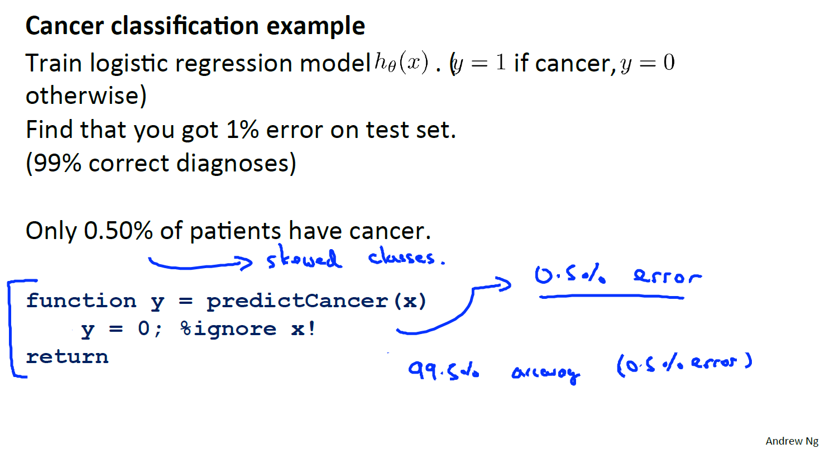
Error metrics for skewed classes: Precision/Recall
Notes:
If model will predict not cancer always, then also 99.50% accuracy will occur. Accuracy is not a good measure here.

Slide 10
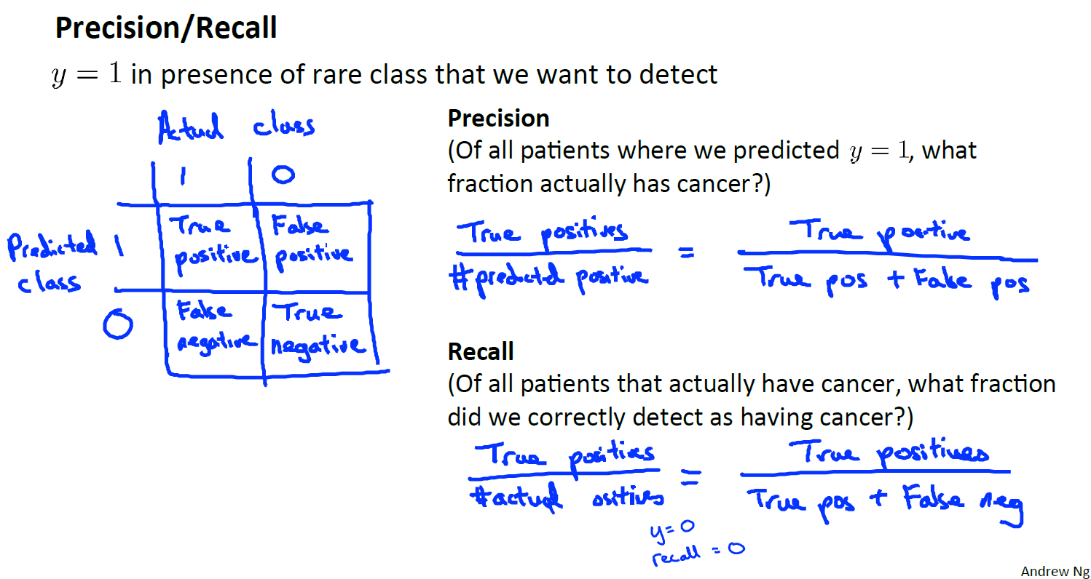
Precision/Recall

Slide 11
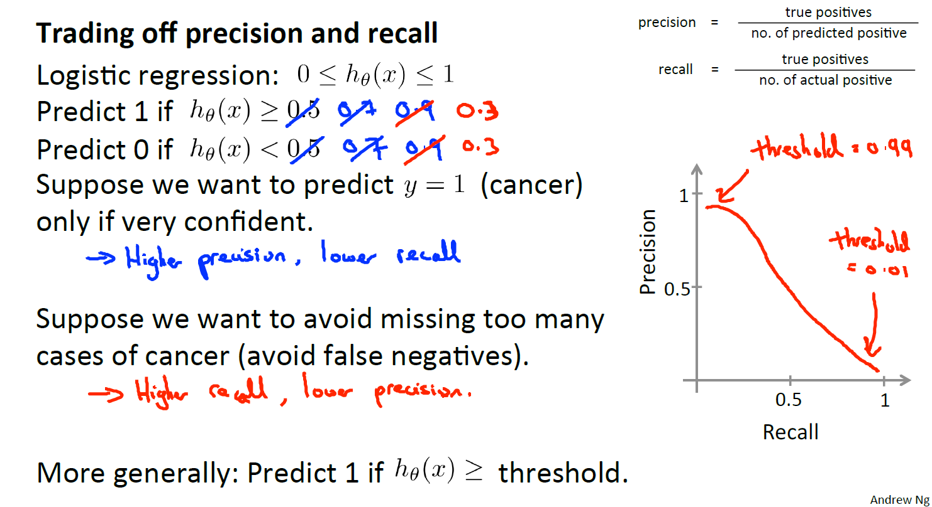
Trading oﬀ precision and recall

Slide 12
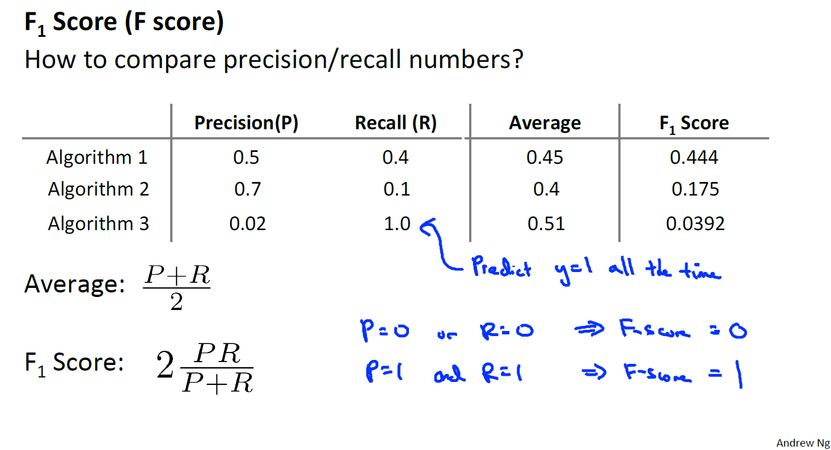
Trading oﬀ precision and recall
Notes:
A higher F1-score generally indicates better model performance. It's particularly useful in scenarios with imbalanced datasets, where accuracy alone can be misleading.
Average is not a good choice as => P=1, R=0 and P=0.5,R=0.5 will both have same average. And hence HM is used.

